Slide 1


NEHRU INSTITUTE OF ENGINEERING AND TECHNOLOGY (AUTONOMOUS) An ISO 9001:2015 and ISO 14001:2015 Certified Institution Affiliated to Anna University, Chennai, Approved by AICTE, New Delhi & Recognized by UGC with 2(f) & 12(B), Re-accredited by NAAC with "A+" NBA Accredited UG Courses: AERO | CSE | ECE | EEE | MECH | MCT Nehru Gardens, T.M.Palayam, Coimbatore-641 105.
DEPARTMENT OF MECHATRONICS ENGINEERING
MR3612 DESIGN AND FABRICATION PROJECT
Guide
Ms. K. Sudhapriya
Assistant Professor
Department of Mechatronics
Submitted by
Iyan Ali - 721422115012
Jishnu M - 721422115016
Shamil Saidalavi - 721422115049
Sreeger H - 721422115050

Slide 2
CONTENTS
TITLE
ABSTRACT
INTRODUCTION
LITERATURE REVIEW
PROBLEMS IDENTIFIED
SOLUTIONS TO PROBLEM
EXISTING SYSTEMS
PROPOSED SYSTEM
BLOCK DIAGRAM
ADVANTAGES
11.APPLICATIONS
12.LIMITATIONS
13.HARDWARE PROTOTYPE
14.RESULT
15.CONCLUSION
16.FUTURE SCOPE
17.REFERENCE

Slide 3
TITLE
“Electrically Actuated Garbage Disposal System With Automated Alerts”

Slide 4
ABSTRACT
The exponential increase in urban population has led to a surge in waste generation, which poses significant challenges to waste management authorities.
Conventional garbage collection systems are inefficient, often leading to overflows, unhygienic conditions, and increased costs.
This project proposes an Electrical Garbage System using the Internet of Things (IoT) to enhance the monitoring and management of waste in real time. By integrating smart sensors, microcontrollers, and IoT communication modules, the system can detect garbage levels in bins and notify the concerned authorities when they need to be emptied.
This approach aims to optimize garbage collection routes, reduce operational costs, and improve urban cleanliness.

Slide 5
INTRODUCTION
Effective waste management is a critical concern in modern urban development. Traditional waste disposal methods lack efficiency and responsiveness, resulting in overflowing bins, environmental pollution, and public health hazards.
As cities grow, so does the complexity of managing municipal solid waste. Implementing IoT – based smart city solutions is making the urban life more convenient and safer.
With the advent of IoT technology, it is now possible to create intelligent systems that can monitor waste levels and automate waste collection processes.
This project aims to design and implement a smart garbage monitoring system that utilizes IoT to streamline waste management, improve hygiene, and contribute to the creation of smart cities.

Slide 6
LITERATURE REVIEW
Sl.No. | Title of the paper,Authors,Journal Name,Year of Publication | Advantage | Disadvantage
1 | “Smart Dustbin and Garbage Monitoring System Using Internet of Things,” Priyanka Thirumugam, Daminda Herath and Shehan Amarasooriya, 5th International Conference on Advancements in Computing 2023 | Enables efficient waste management with real time monitoring. | Limited coverage in areas with poor internet connectivity.
2 | “Design and development of IOT based Garbage Monitoring and Management System,” W. M. Nooriman et al.,Journal of Physics:Conference Series, vol. 2107, no. 1, 2021 | Facilitates intelligent routing and scheduling, leading to cost savings. | Data collection might raise privacy issues if not properly managed

Slide 7
LITERATURE REVIEW
Sl.No. | Title of the paper,Authors,Journal Name,Year of Publication | Advantage | Disadvantage
3 | “IoT based smart dustbin,” T. Maddileti and H. Kurakula, International Journal of Scientific and Technology Research, vol. 9, no. 2,pp. 1297–1302, 2020. | Provides instant updates on fill levels, preventing overflow. | Does not address issues like waste segregation or illegal dumping.
4 | “Smart waste bin system: a review,” Ayodeji Noiki, Sunday A. Afolalu, Abiodun A. Abioye, Christian A. Bolu and Moses E. Emetere, IOP Conf. Series: Earth and Environmental Science 655, 2021 | User engagement, includes user feedback features for better Service. | Dependence on a sole network for real-time updates.

Slide 8
PROBLEM IDENTIFIED
In India an average of 0.14 million tonnes garbage is generated daily, 4.7 million tonnes garbage is generated daily across the world.
6 million tonnes is expected to be generated by 2025.
With this amount of garbage being generated, the manual monitoring may sometimes leads to overflowing bins and irregular collection.
Such an inefficient system results in frequent contact with waste,increasing health risks and spread of bad odors.
And at times this shows an effect of individuals getting certain diseases and it also impacts on environment in a few ways.

Slide 9
SOLUTION TO PROBLEM
A garbage bin which can accept the garbage without the need of human touch and segregate the garbage according to the criteria just after accepting it.
The bin will be having separate half for different waste and it monitors the level inside each half.
Once the level in either of the half has reached threshold level ,alerts will be sent to the management team or specific personnel who manages the waste collection in the specific area.
For the network issues not to affect the proper waste management, personnel is alerted via both SMS and IoT app based notifications.
The bin won’t further accept any input into it unless the waste inside has been cleared.

Slide 10
EXISTING SYSTEMS
The current garbage collection systems are mostly:
Manual and Time-Based: Garbage trucks follow fixed routes and schedules regardless of bin status.
Lack of Real-Time Monitoring: Authorities are unaware of the fill levels of bins, leading to delayed response.
Inefficiency and Cost: Waste of fuel, labor, and time in collecting partially filled or empty bins.
Environmental and Health Issues: Overflowing bins contribute to unsanitary conditions, bad odors, and pollution.
These issues necessitate a smarter and more adaptive solution.

Slide 11
PROPOSED SYSTEM
The proposed IoT - based Garbage Disposal System involves:
Smart Bins: Each bin is equipped with IR sensors to measure the garbage level.
Micro-controller Unit (ESP32): Processes sensor data and controls the IoT module.
IoT Communication Module (Wi-Fi,GSM): Transmits real-time data to a central server or cloud platform.
Central Monitoring Dashboard: Displays bin status (Empty,Half,Full) and generates alerts for full bins.
Mobile App/Web Interface: Enables sanitation workers or administrators to track bin status and optimize collection routes.
Optional Add-on: GPS tracking.
Working:
When the garbage level in any bin reaches a predefined threshold, the system sends a notification to the server. The server updates the dashboard, and an alert is sent to waste management personnel to collect the waste.

Slide 12
BLOCK DIAGRAM
Ultrasonic
Sensor
Blynk
IoT
Wi-Fi
IR Sensor 1
ESP 32
SMS
Alert
Phone
GSM
IR Sensor 2
Servo
Motor
Sorter
LCD
Moisture
Sensor

Slide 13
ADVANTAGES
Enhanced Waste Monitoring
Improved Hygiene and Safety
Efficient Waste Management System
Remote Management
Environmental Benefits
Encourages Proper Waste Disposal
Decreased Labour

Slide 14

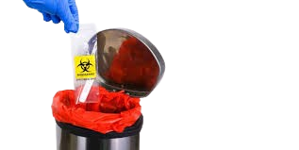


APPLICATION
Empowered ‘Swachh Bharat Mission’.
E-governance based on digital India.
Reduce environmental pollution.
Prevents the spread of diseases from these wastes.
Real time based cleaning of our cities.
Paves the way for a hygiene environment.
It can be helpful for improving ‘Life Quality Index’
It makes our system transparent between municipal corporation, workers and public

Slide 15
LIMITATIONS
Component Maintenance Challenges
Dependence on Network Connectivity
Dependence on Power
Cost-Benefit Balance
Environmental Factors

Slide 16
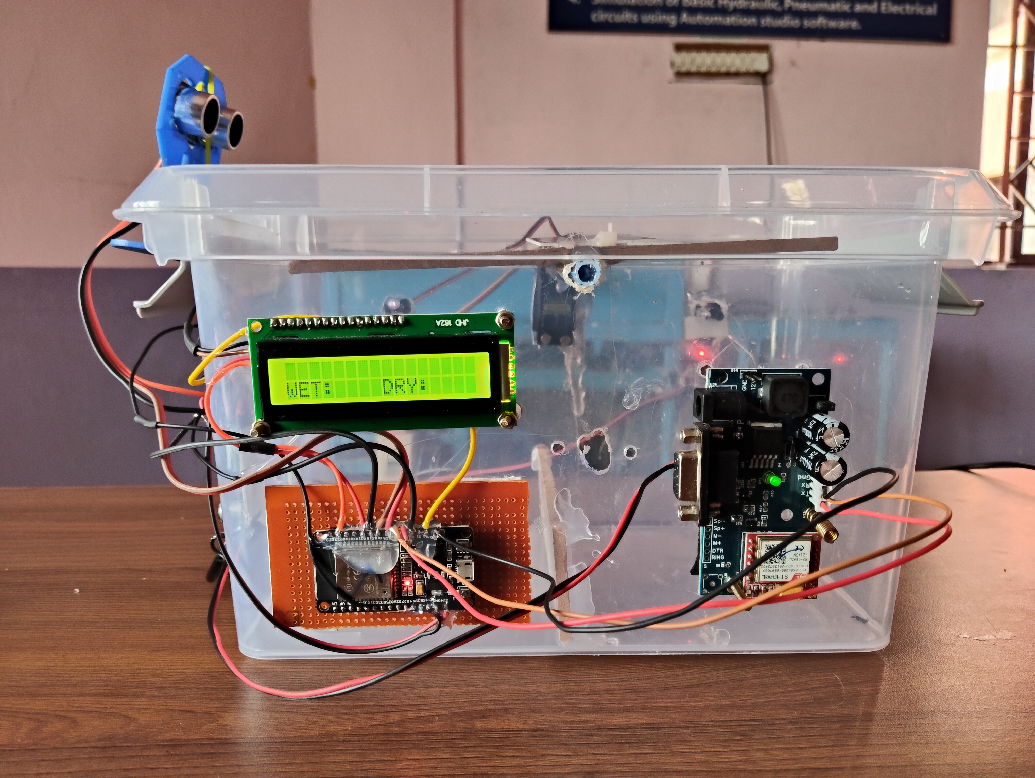
HARDWARE PROTOTYPE
Ultrasonic
sensor
LCD Screen
GSM Module
ESP32

Slide 17
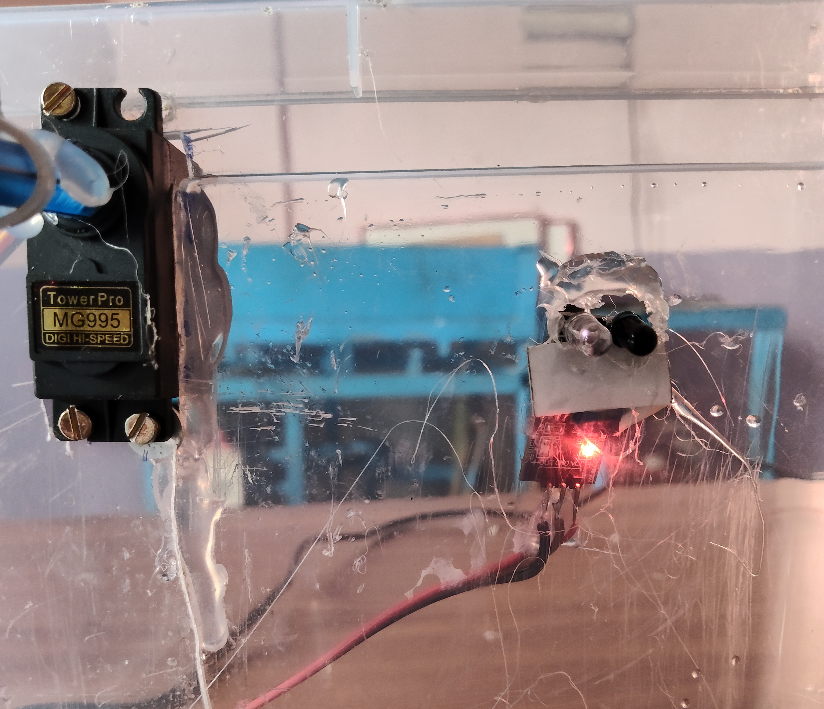
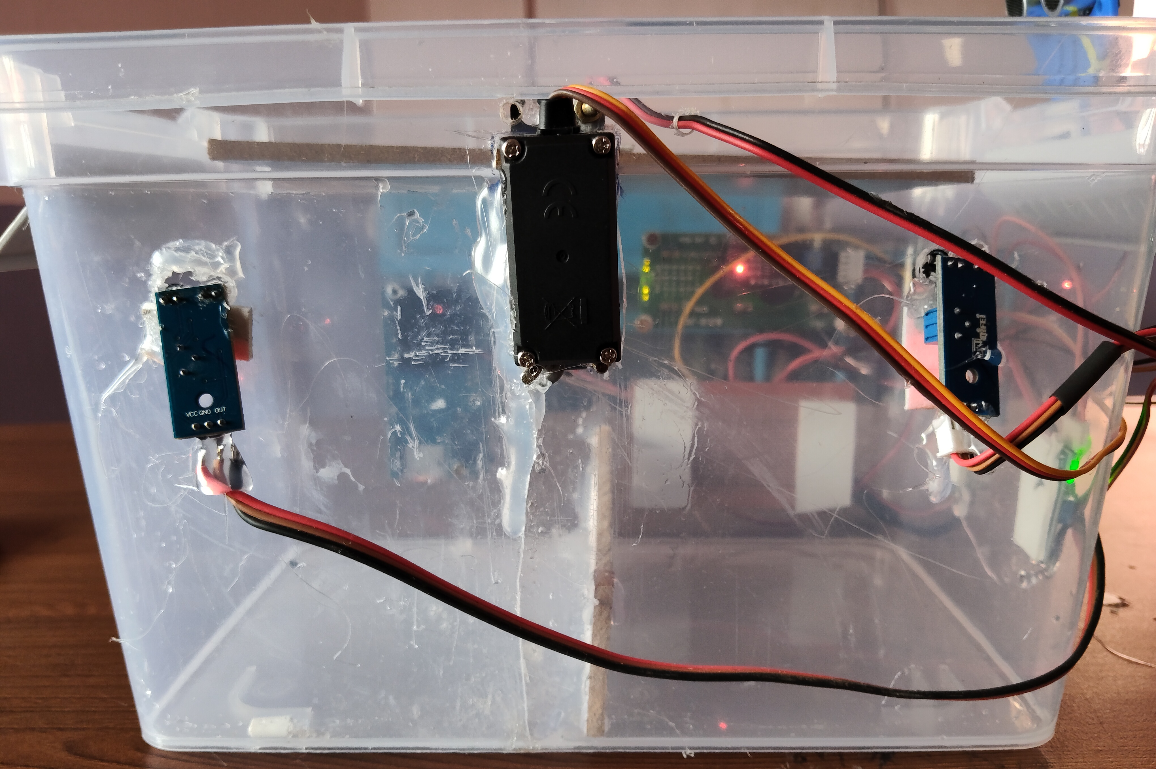
HARDWARE PROTOTYPE
Servo Motor
Servo Motor
IR Sensor
IR Sensor

Slide 18
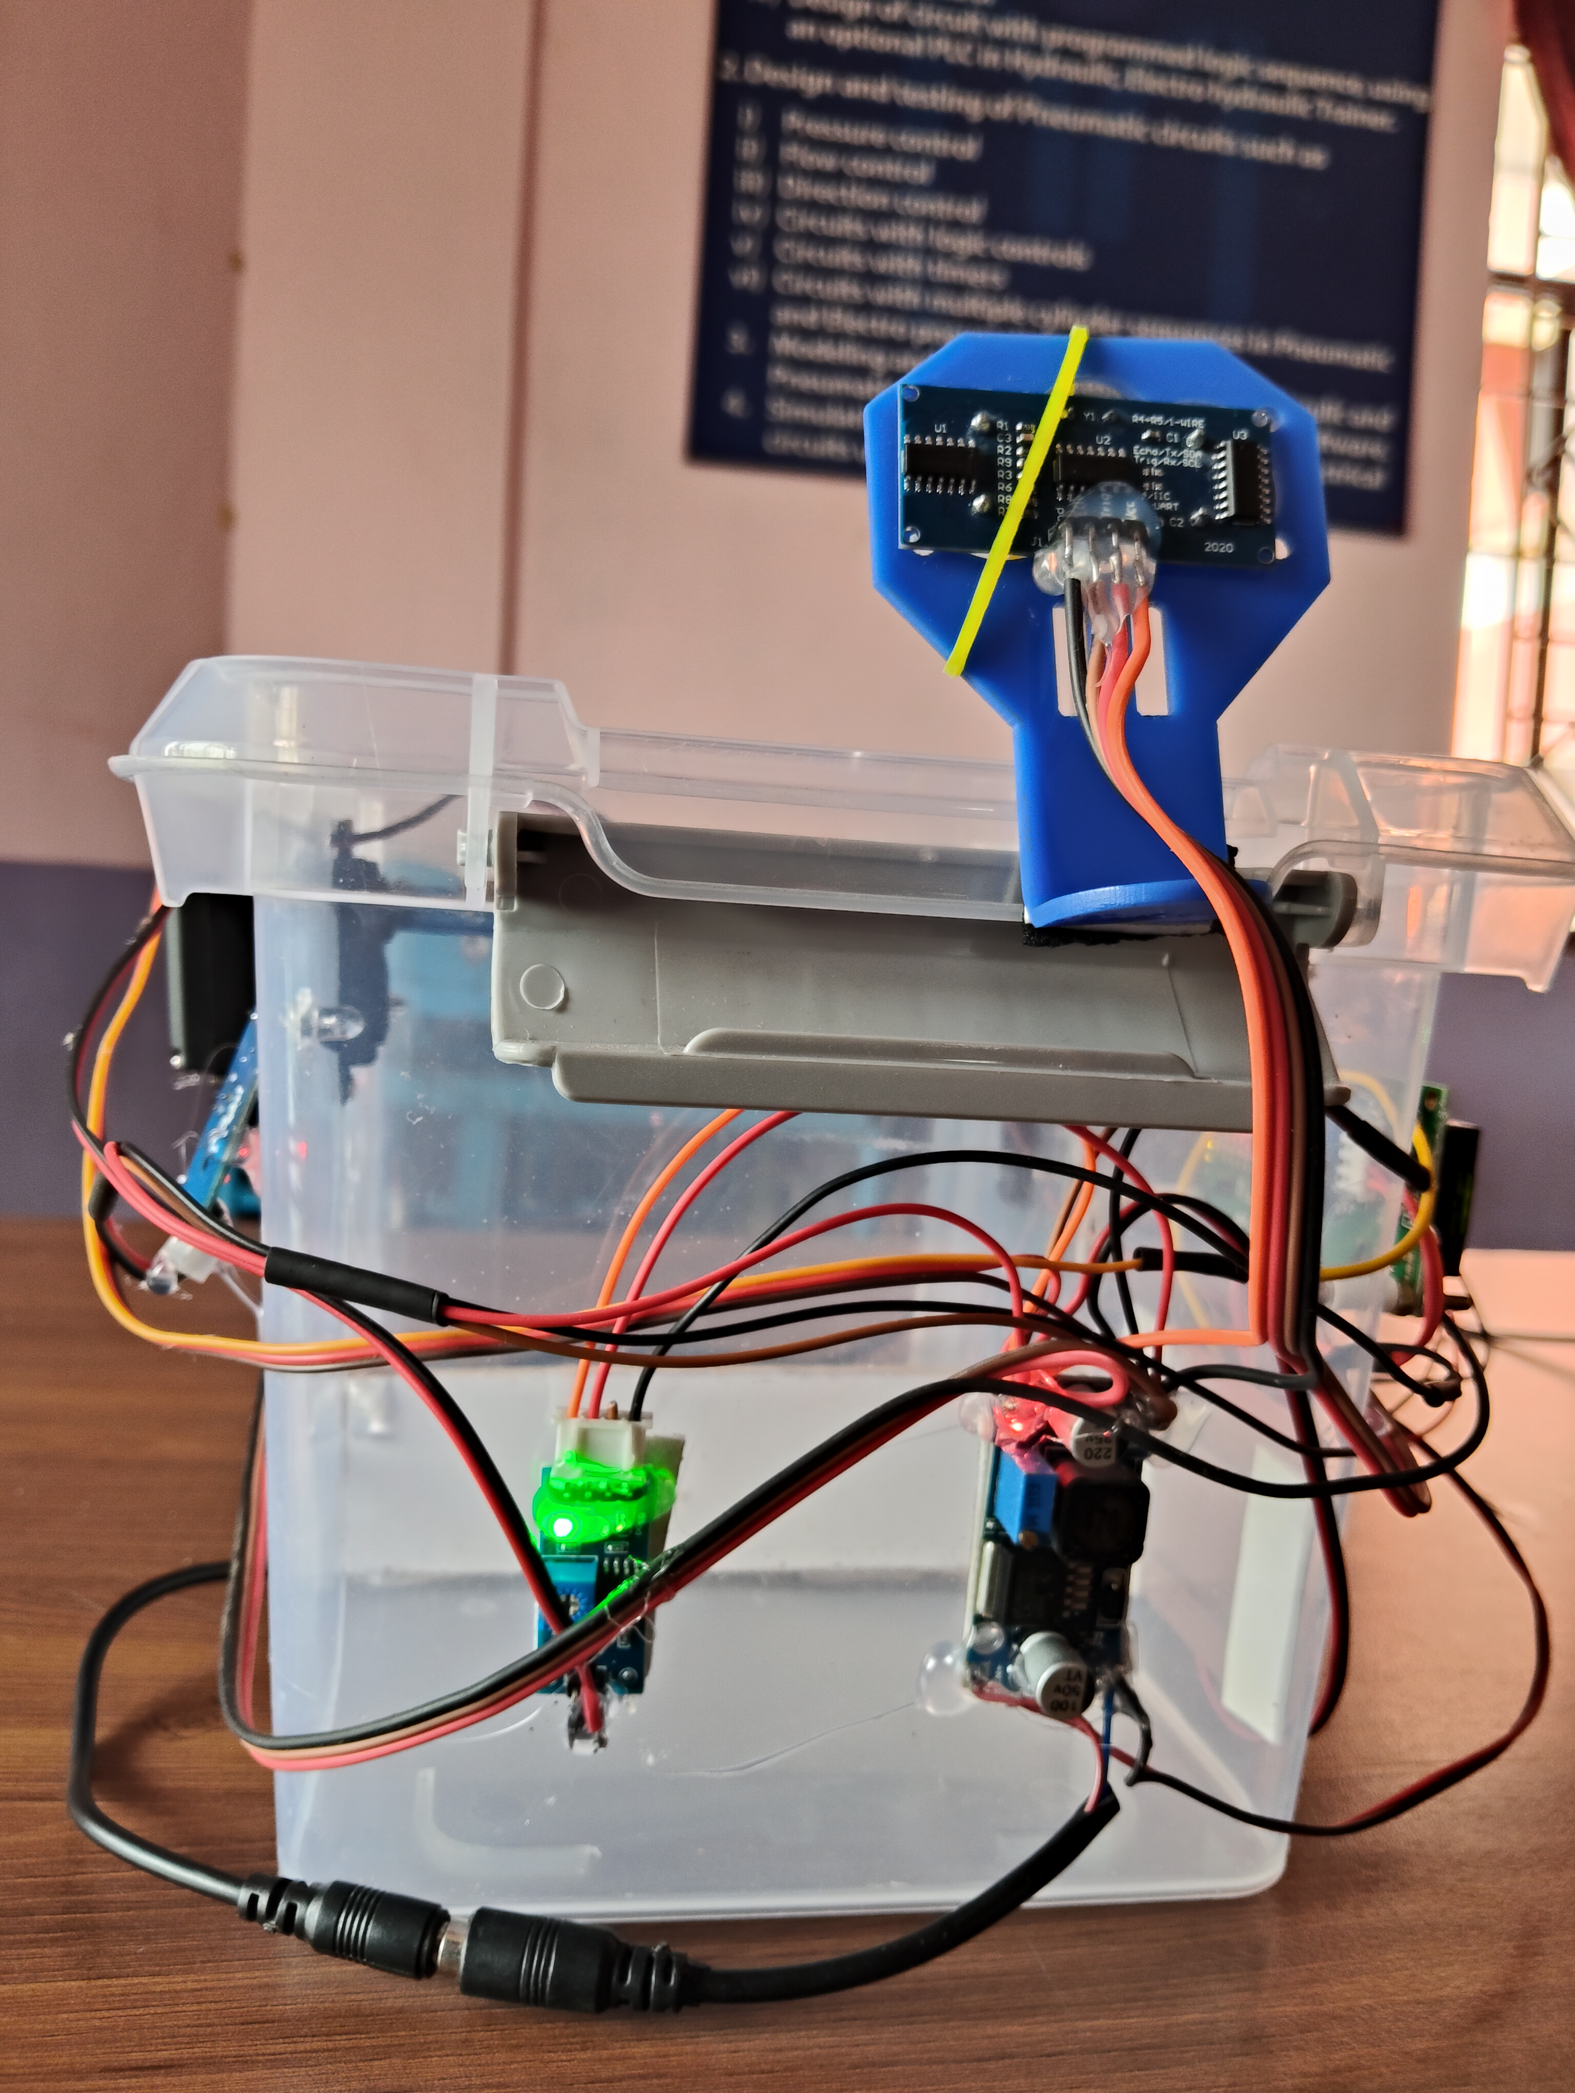
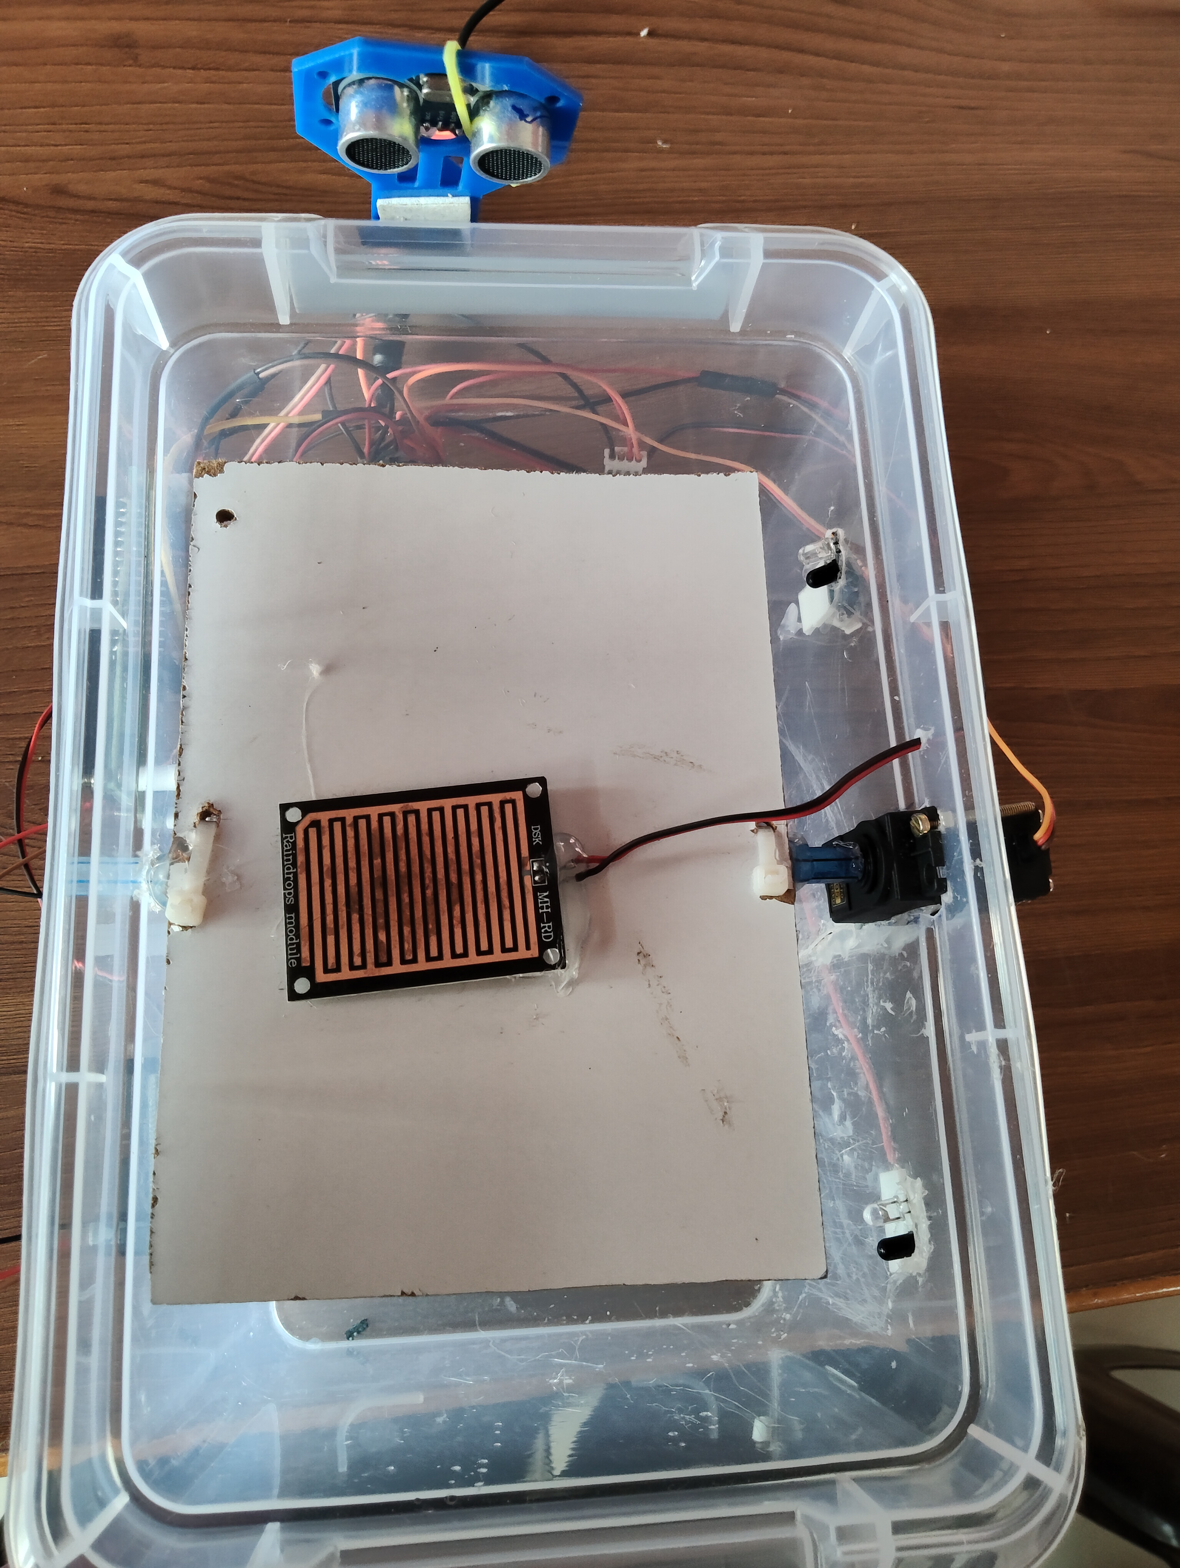
HARDWARE PROTOTYPE
Buck Converter
Pot for Raindrop Sensor
Raindrop Sensor
Power Port

Slide 19
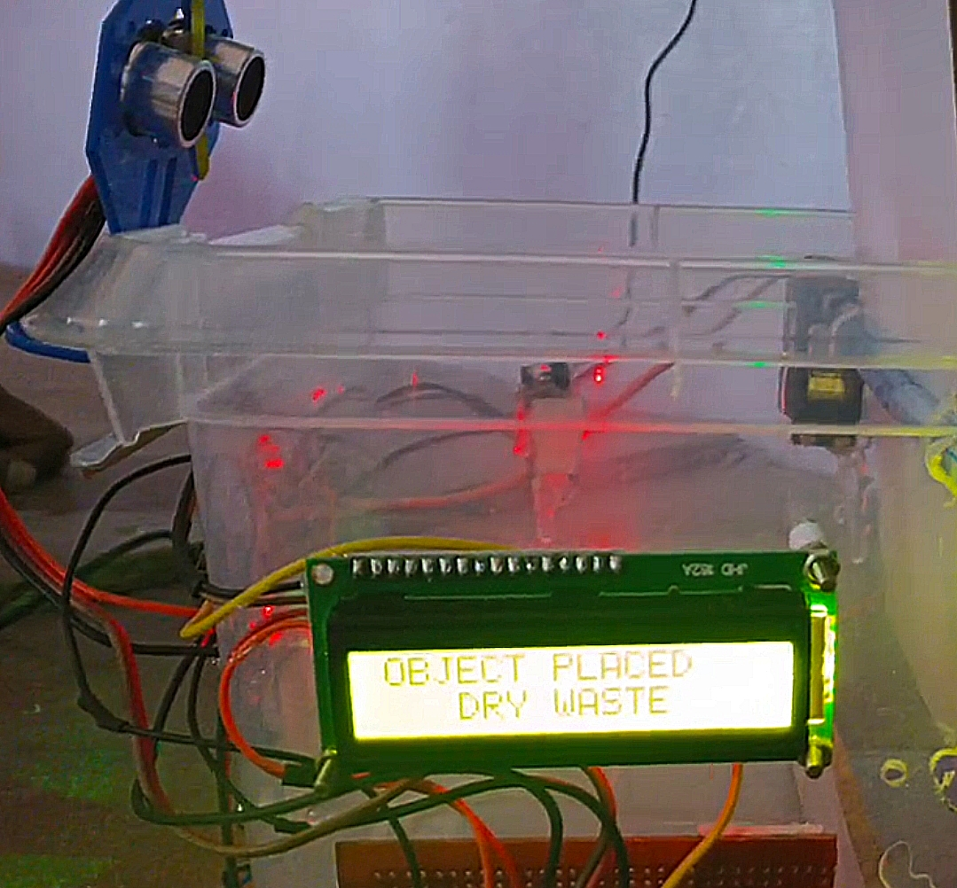
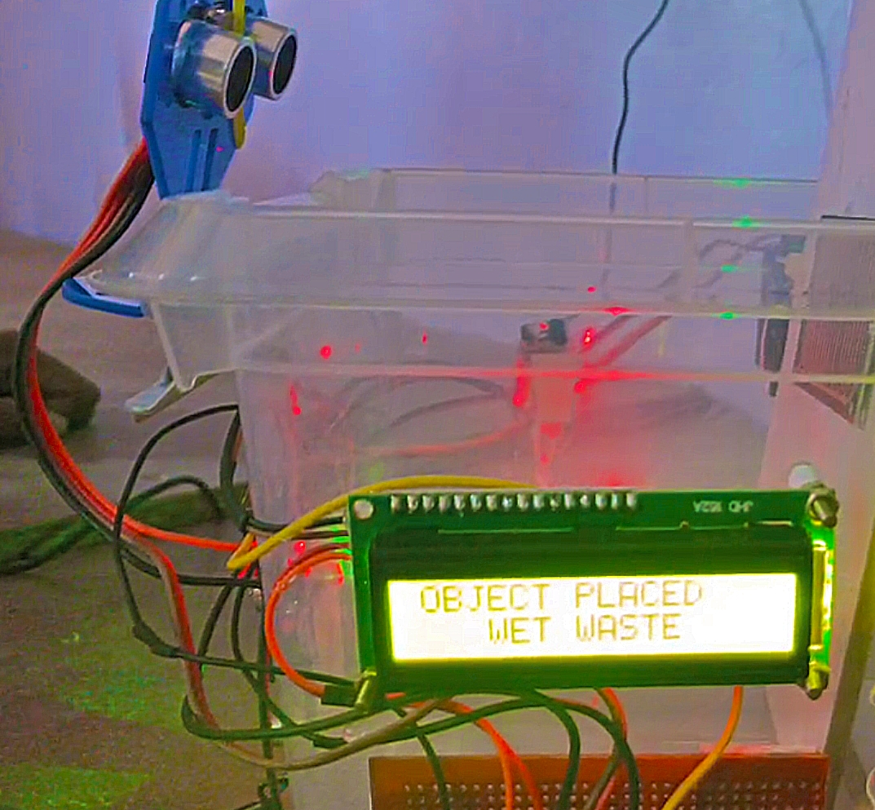
RESULT
LCD - DRY WASTE
LCD – WET WASTE

Slide 20
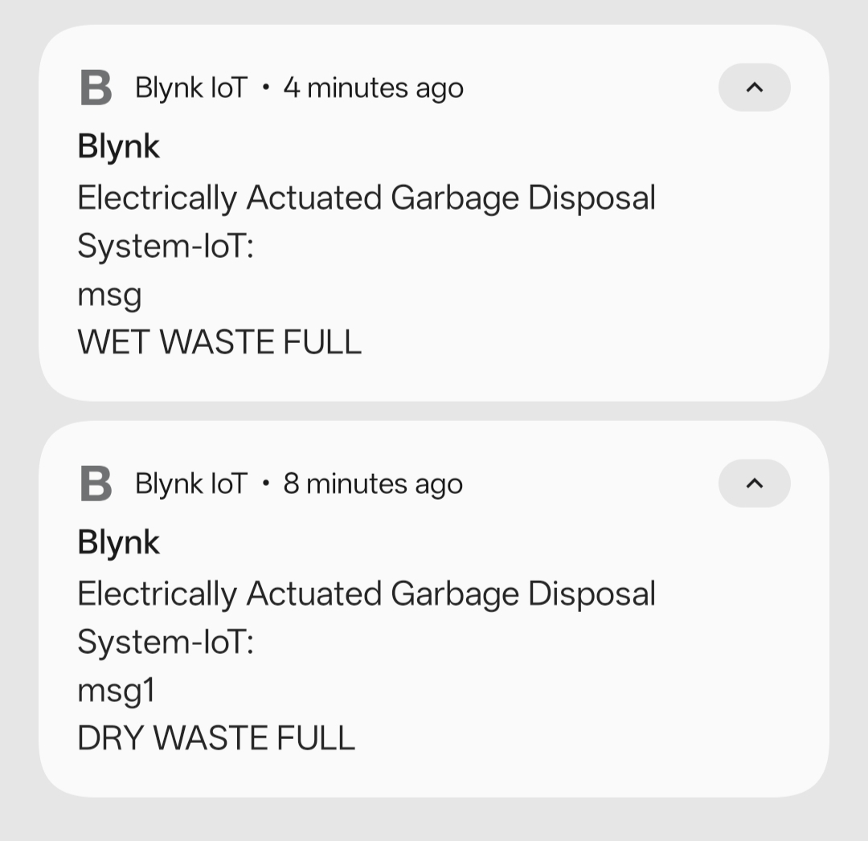
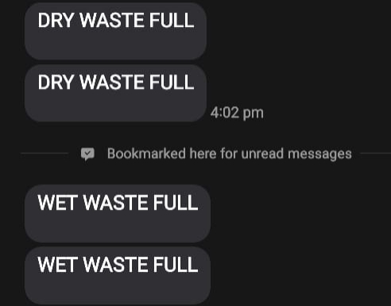
RESULT
BLYNK NOTIFICATIONS
SMS VIA GSM

Slide 21
CONCLUSION
A simple but useful system called “Electrically Actuated Garbage Disposal System With Automated Alerts” using IoT provides an innovative and effective solution to the challenges of urban waste management. By enabling real-time monitoring, alert generation, and data-driven route optimization, the system enhances operational efficiency and hygiene. The integration of IoT in garbage management is a step toward building smart cities with sustainable and responsive public services. By the project, the garbage bin stays closed, so that waste is not exposed (to avoid flies and mosquitoes) and when you want to dispose of any waste, it will accept them, sort according to the type. Also it checks whether the garbage has reached the maximum level in any of the partitioned half to alert the caretaker. It is also designed to prevent accepting waste when any of the half is on maximum level(so the spread of diseases, odors from these garbage can be avoided and overflow is prevented).

Slide 22
FUTURE SCOPE
Further Improvements in hygiene can be achieved by using a mechanism to seal the garbage bag automatically once it reaches its maximum. A mechanism actuated by electric motor and lead screw with collapse structure.
This garbage disposal can be improved to automatically segregate plastics, metals, biodegradable, recyclable, and non-biodegradable wastes, addressing major solid waste management issues.
With further advancements, mechanisms can be developed to deter animals and birds from accessing the waste,thereby preventing environmental pollution and contamination.
And by adding a method to use solar energy for the working,it also increases the sustainability.
Labour cost reduction can be done by using robotic dustbins or centralized collection methods to make the garbage available at the plant, machine learning for waste pattern analysis and integration with municipal ERP systems for seamless operation.
Moreover from a social point of view the persons involved in garbage collection, segregation and disposal will be prevented from being infected and paves the way for their healthy well-being.

Slide 23
REFERENCE
Priyanka Thirumugam, Daminda Herath and Shehan Amarasooriya, “Smart Dustbin and Garbage Monitoring System Using Internet of Things,” 5th International Conference on Advancements in Computing 2023 doi:10.1109/ICAC60630.2023.10417205
W. M. Nooriman et al., “Design and development of IOT based Garbage Monitoring and Management System,” Journal of Physics:Conference Series, vol. 2107, no. 1, 2021.doi:10.1088/1742-6596/2107/1/012002
Zhang, L., & Chen, Y. (2023).“Design and Implentation of a Smart Waste Collection System with IoT sensors,” IEEE Internet of Things Journal,10(2),890-899. doi:10.1109/JIOT.2023.1234567
S. S. M. Ilyas, M. A. Halim, N. A. Wahab, and N. Ibrahim, “IoT-based Smart Garbage Monitoring,” Journal of Computing Research and Innovation (JCRINN), vol. 6, no. 2, pp. 21–28, Sep. 2021.
T. Maddileti and H. Kurakula, “IoT based smart dustbin,” International Journal of Scientific and Technology Research, vol. 9, no. 2,pp. 1297–1302, 2020.
Ayodeji Noiki, Sunday A. Afolalu, Abiodun A. Abioye, Christian A. Bolu and Moses E. Emetere, “Smart waste bin system: a review,” IOP Conf. Series: Earth and Environmental Science 655, 2021

Slide 24
THANK YOU!

